Slide 1
COVID 19 Case Study-
Correlation between vaccination and case number
Group 1

Slide 2
Data we have:
Testing and vaccine data
John Hopkins https://github.com/govex/COVID-19/tree/master/data_tables
Covid-19 patient characteristics data
CDC https://gis.cdc.gov/grasp/COVIDNet/COVID19_5.html
Covid-19 in Prisons, Jails and Detention Facilities
NYtimes https://github.com/nytimes/covid-19-data/tree/master/prisons
Base on the available datasets, we will define our project question:
Notes:
Population of the country, partially vaccinated, and fully vaccinated, the number of covid cases

Slide 3
Question to investigate:
What is the temporal trend of covid cases and vaccination rate globally?

Slide 4
Main Idea:
Covid case number is always at stake for the globe. We want to see the correlation between vaccination counts and new case counts in countries around the world.

Slide 5
Preliminary results
165 countries represented in the data

Slide 6
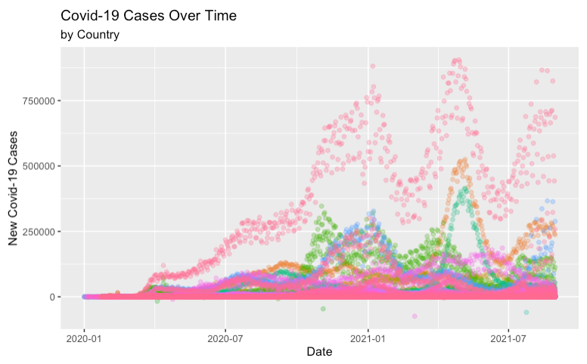
Fig 1

Slide 7
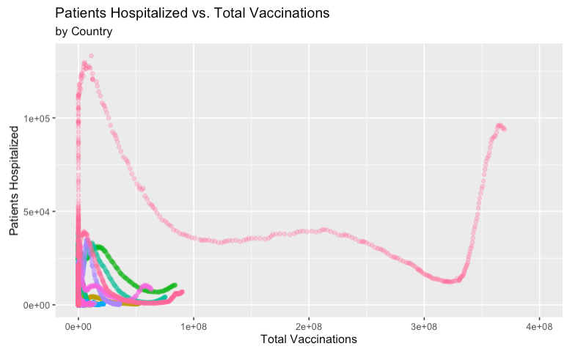
Fig 2
Steady decline until what would appear to be delta variant hitting
Curves stop at last date on record
Notice certain countries have much less access to the vaccine
However lower vaccination also due to population size

Slide 8
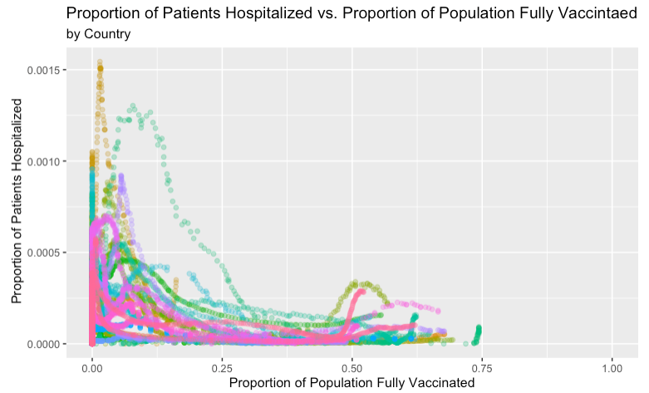
Fig 3

Slide 9
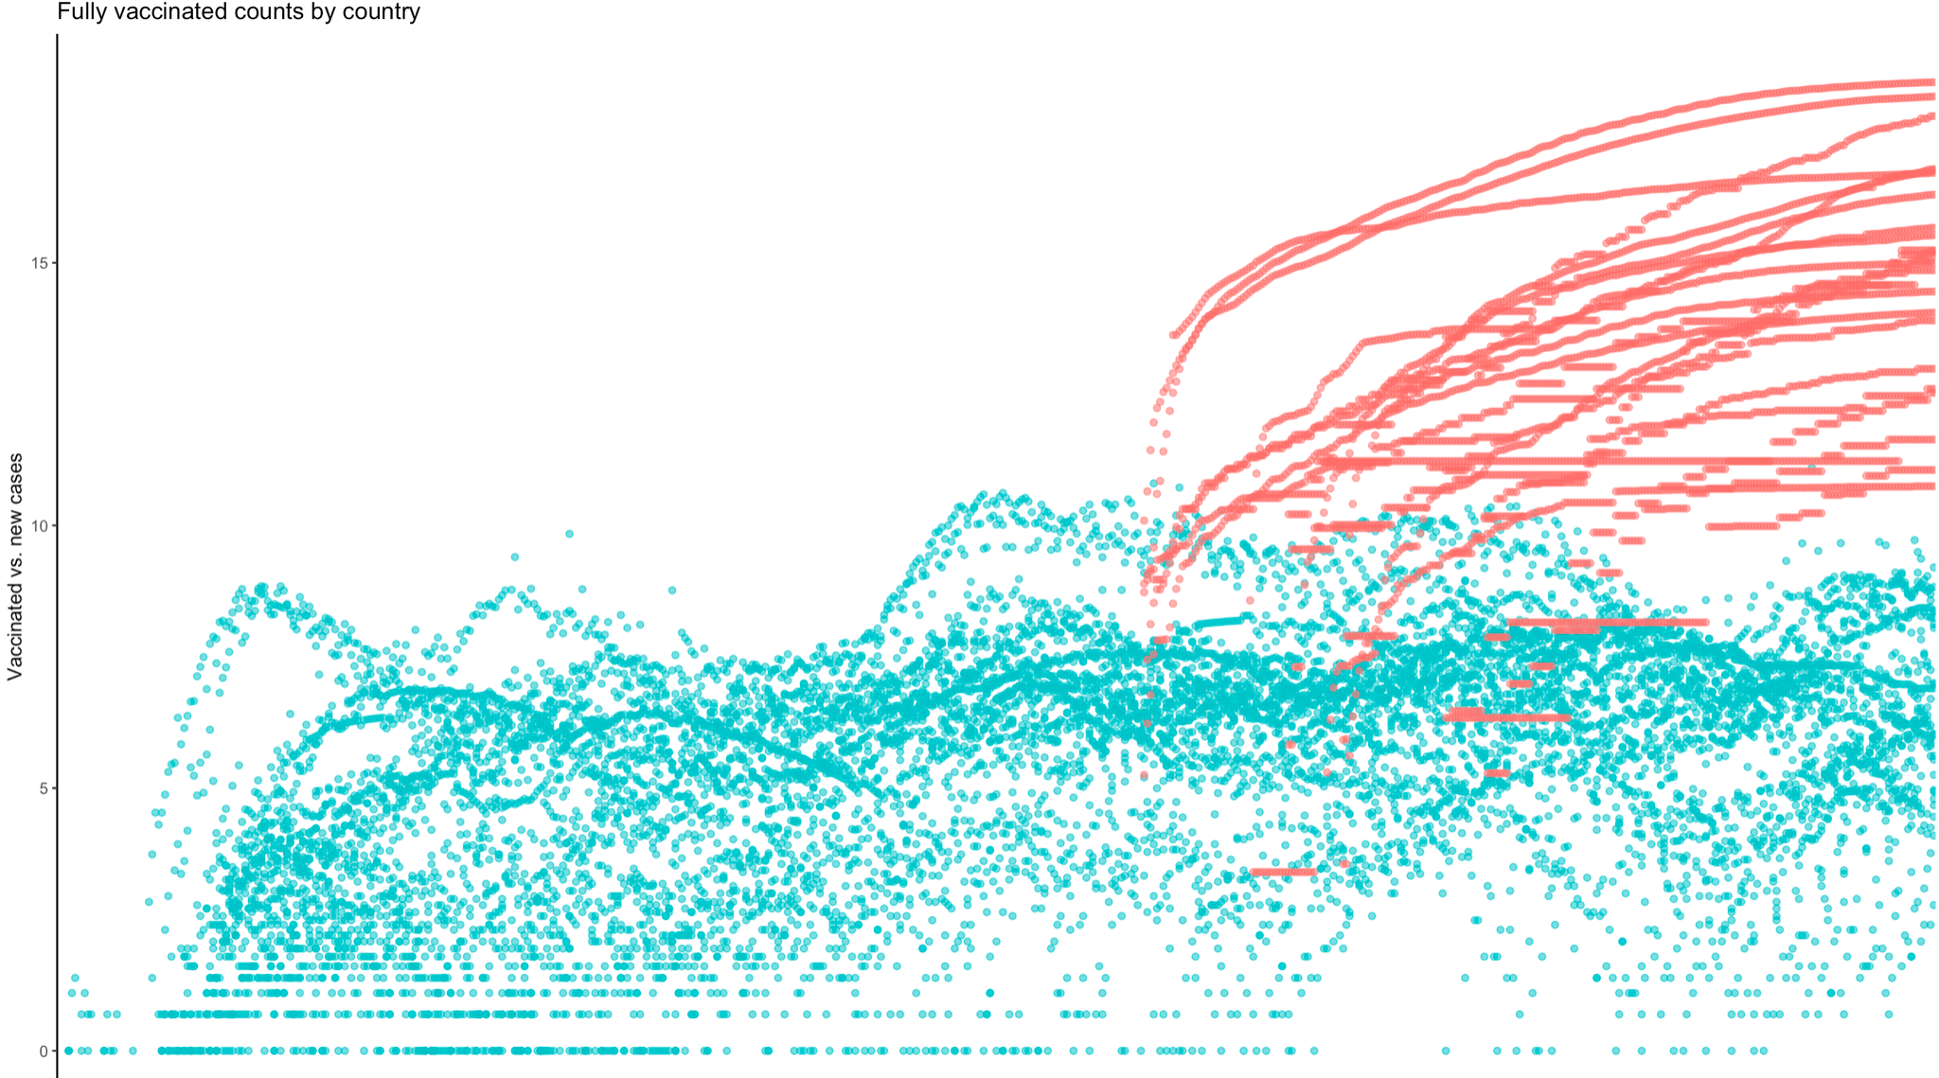
Fig 4

Slide 10
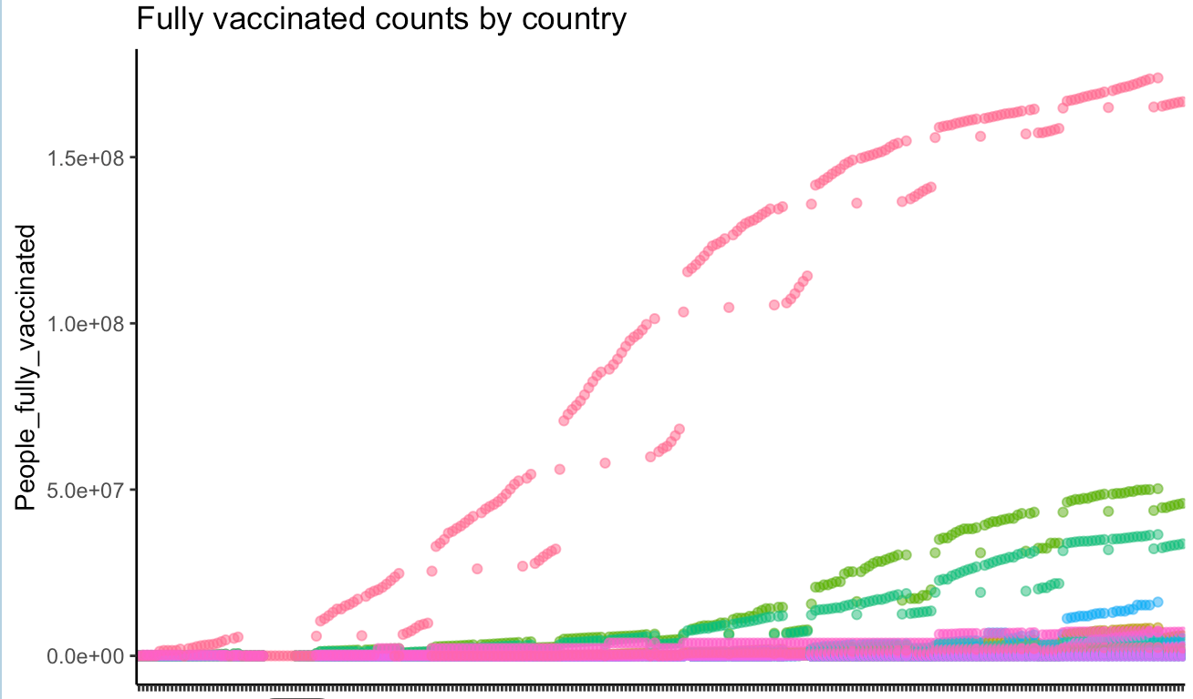
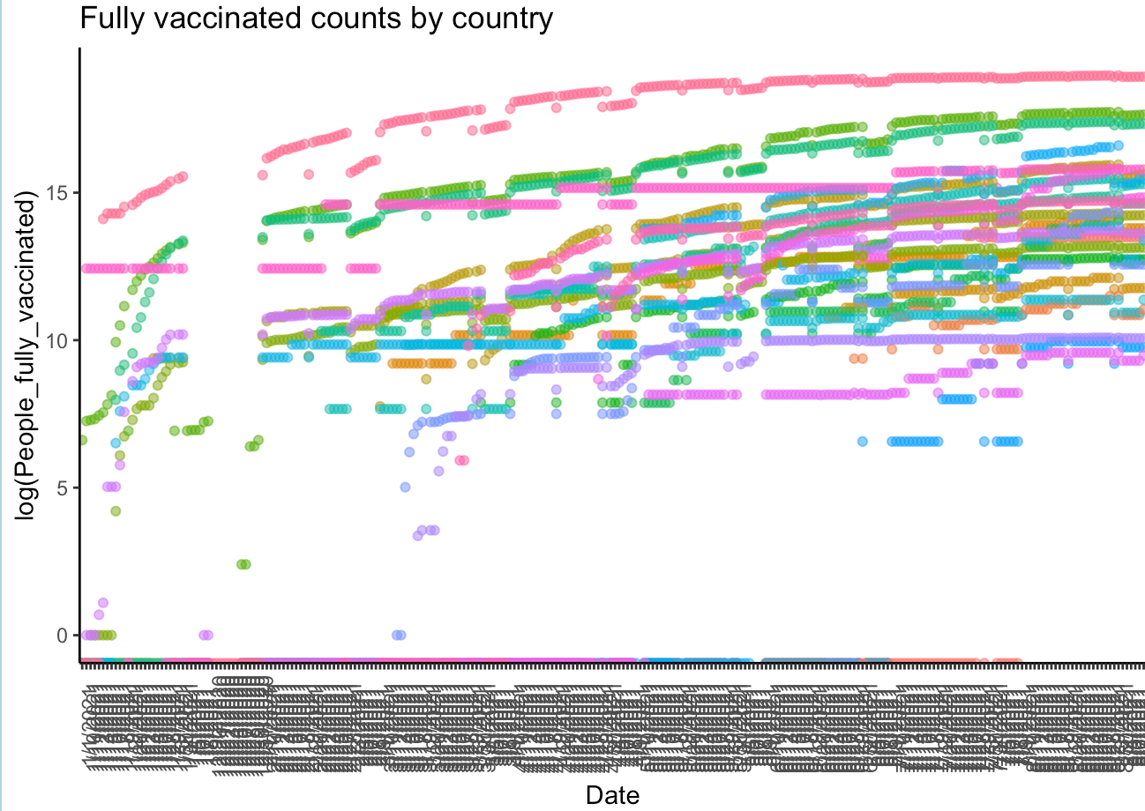
Fig 5,6
US has the highest count of fully vaccinated people in the world
Significant differences among countries

Slide 11
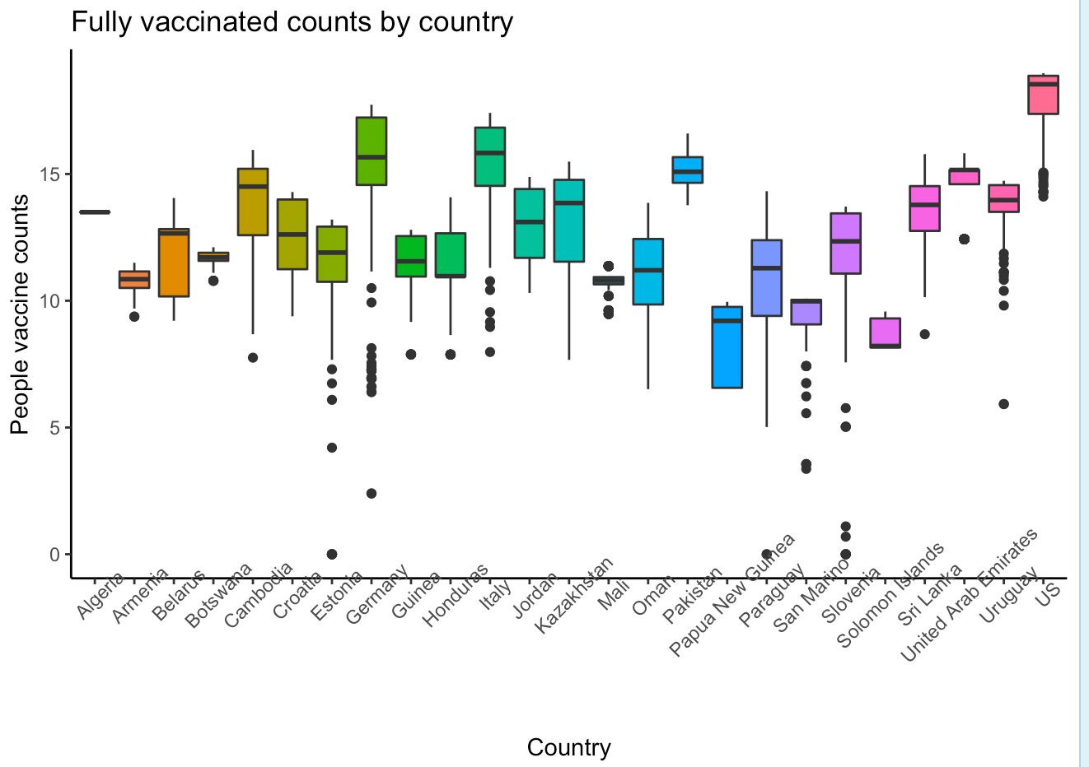
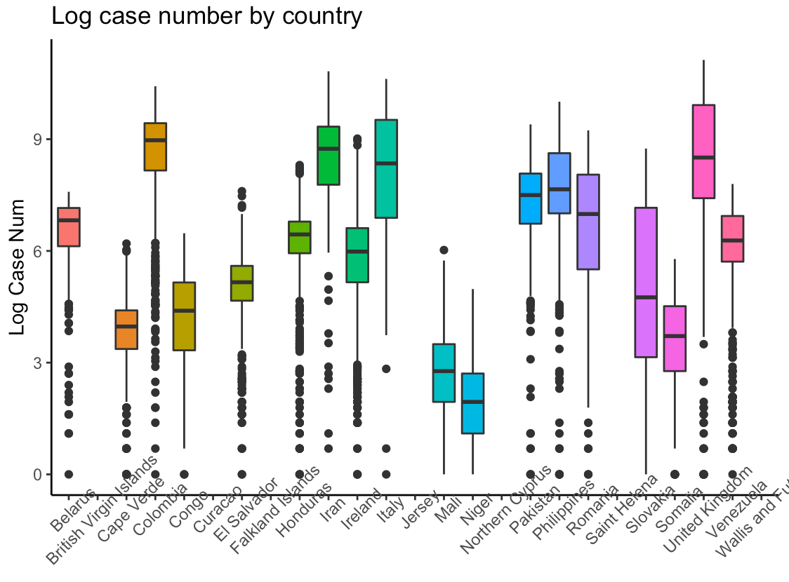
Fig 7,8

Slide 12
Challenges:
Missing data
Great disparity among countries
Have to do log transformation to make some countries visible
Negative death numbers (we assumption is that’s the correction of death numbers)
With the delta variant, the prediction based on the past data may not be very accurate

Slide 13
Next steps
Move towards looking at proportion
Selectively filter out outlier countries
Consider modeling with the covariates such as population_density and gdp_per_capita to predict the vaccination and new cases numbers for countries
Can we predict the number of new cases for a given country to a specific date?
Think about what kind of shiny app representation could best get our points across
Notes:
Proportion of covid cases and vaccination numbers

